Slide 1
Job Search during COVID-19 Pandemic – Skills to Succeed in the New Environment
St Elizabeth Chapter – Joseph’s People
18May2020
Dan Winand

Slide 2
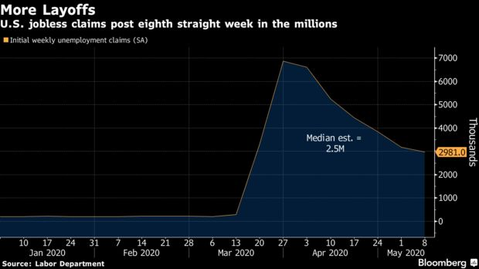
Current Environment
Challenges
Large loss of jobs (36MM) due to COVID-19 – especially entry level, retail (brick&mortar), hospitality
Some jobs may never comeback
Unknown duration of shutdown and pace of restart process
Social distancing impacts to job hunting
Companies scrambling to adapt
Networking difficult
Interview process virtual
9/11 like impact to society
Future uncertain

Slide 3
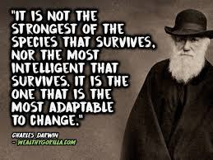
Current Environment
Companies that started during the last recession
Uber
Twitter
Instagram
Pinterest
Venmo
Opportunities
Strong companies/industries still hiring
Evaluate how companies treat their people
Anticipation gradual return to new normal - more recruitment activities ongoing
Sector of workforce may not return – early retirement
COVID-19 healthcare related – pharma, testing, PPE, social distancing
Success to those who adapt to new workplace

Slide 4
Post-COVID Workplace
Social distancing rules will continue for the near future – herd immunity/effective vaccine dependent
Remote working here to stay
Fully or hybrid (3 day office/2 days at home)
Physical changes to office space
Rethinking open concept
Less face to face meeting
Co-workers/customers
5 changes to expect in the workplace after COVID-19
1. FULL DIGITAL TRANSFORMATION, SUPPORTED BY A TRULY
VIRTUAL WORKFORCE
2. FOCUS ON OUTPUTS VERSUS FACE TIME
3. RESPECT FOR WORK-LIFE BLEND
4. STRONGER COMMUNICATIONS
5. INCREASED TRUST, TRANSPARENCY, AND EMPATHY
Fast Company – 4/27/20

Slide 5
Post-COVID Job Skills
Adaptability and Flexibility
Rapidly changing environments
Tech Savviness
Effective use of video technology (Zoom, Teams, Skype) for communication
Creativity and Innovation
Ability to quickly shift gears
Data Literacy
Identifying trends
Critical Thinking
Objectively evaluate information from diverse sources
Digital and Coding Skills
Leadership
Inspire teams remotely
Emotional Intelligence
Connect with team remotely
8 Job Skills To Succeed In A Post-Coronavirus World
Adaptability and Flexibility
Tech Savviness
Creativity & Innovation
Data Literacy
Critical Thinking
Digital And Coding Skills
Leadership
Emotional Intelligence
Commit to a Lifetime of Learning
Forbes – 4/17/20

Slide 6
Success Story
Candidate: MBA with several years of experience, making a career switch from government to finance.
Length of search: 7-months (had soft offers prior to Covid-19 hitting
Success: Landed a job as a consultant focused on supporting public utility companies and governments in assessing telecommunication infrastructure investments.
Tips:
Use this as a time to think about your goals and what want to do rather than just finding a job. This focuses your search and can help you start to see this crisis as an opportunity.
Once you have had some time to reflect, start reaching out to your network: former colleagues, mentors, friends, etc.
Don't be afraid to tell them why you are reaching out - there is no shame in losing your job right now and people will be willing to help you out. My offer came from reaching out to a former colleague and sharing my story candidly. She put me in touch with a couple people in her company that were hiring and it turned out they had a role that was a perfect fit.

